Slide 1


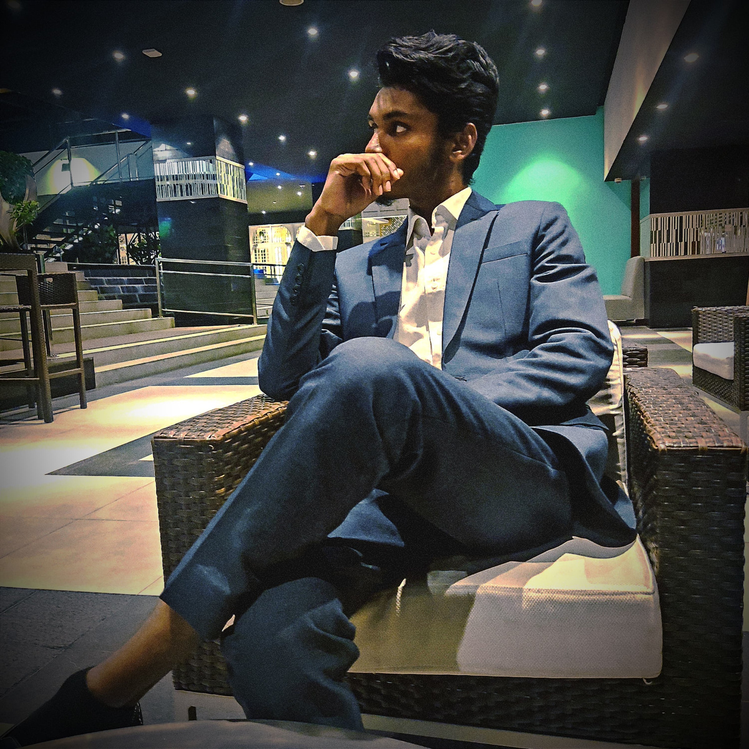

Hello Everyone.
I’m Md. Sabit Bin Arif
Portfolio

Slide 2



Table of Content
1. About Me
2. Resume
3. Education
4.Work Experience
5.Skills & Proficiency
6. Academic Achievements
7. Academic Certificates
8. Other Certificates
9. Awards
10. Projects
11. Other Courses
12. Extra Curricular
13. Professional Membership
14. Contacts

Slide 3


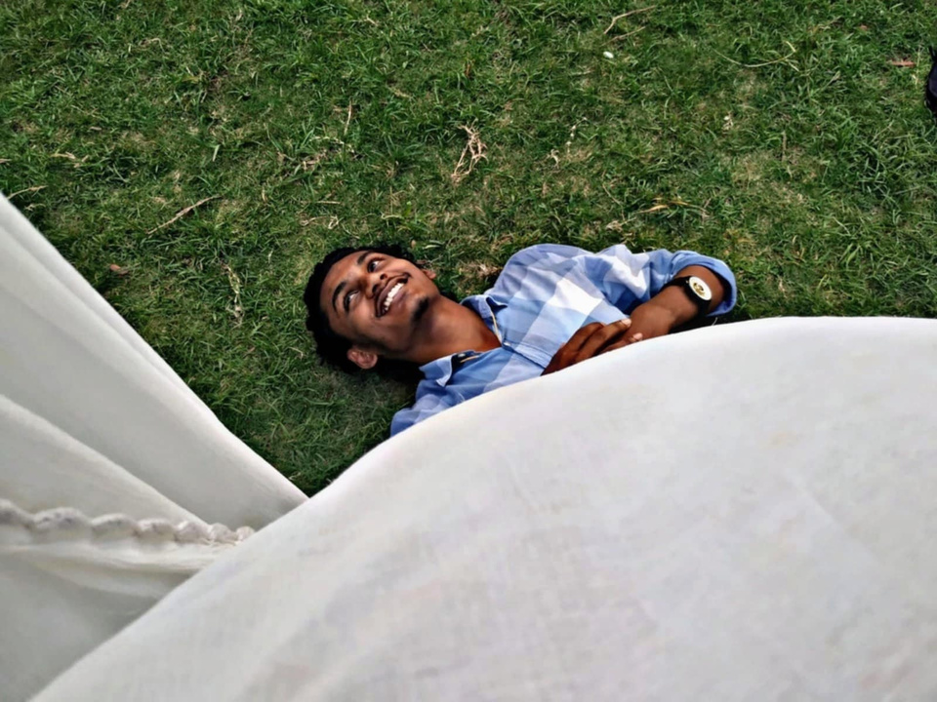
About Me
Thank you for the chance. It would be quite intriguing for me to work for this company. I am comfortable with a wide range of exploits and surroundings. I like being busy with work and new initiatives, and I appreciate my job.

Slide 4
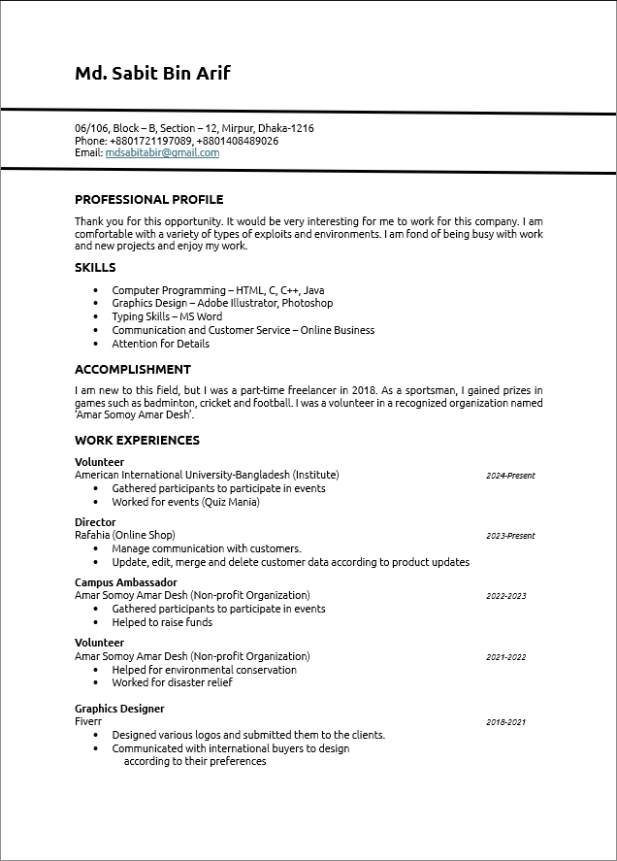
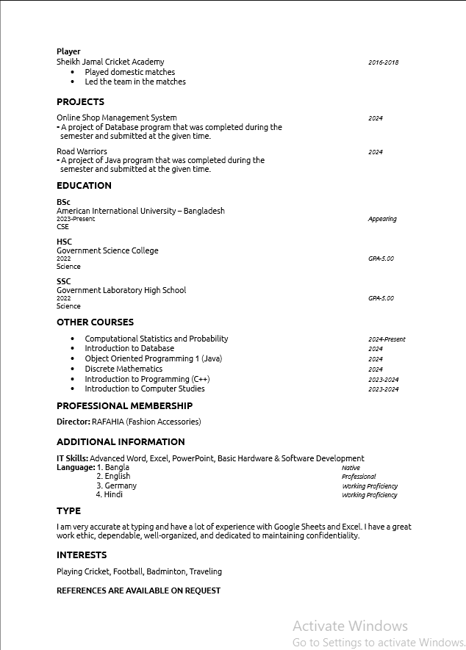
Resume
1 out of 2
2 out of 2

Slide 5
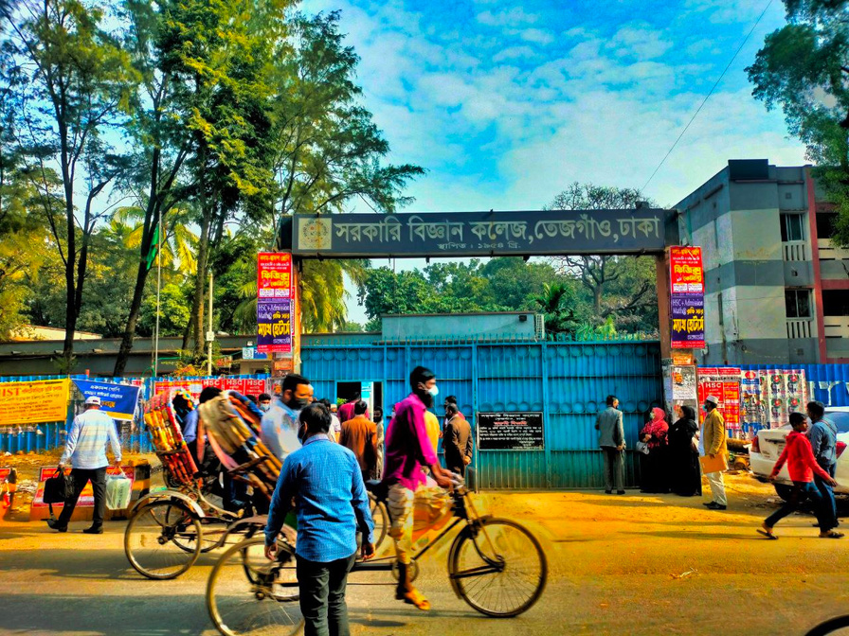
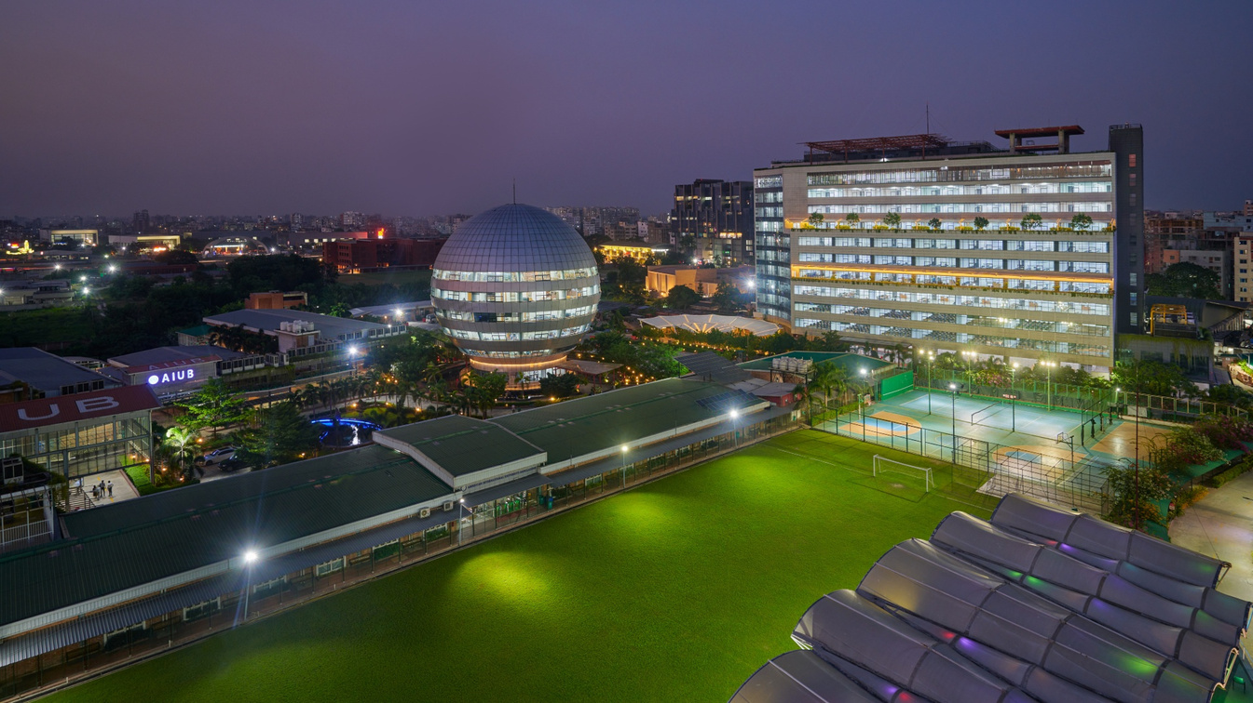
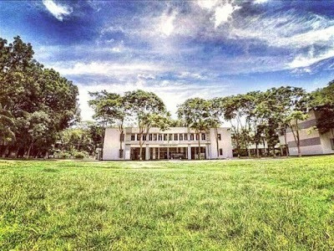
Education
2027
(Approximate)
BSc
American International University-Bangladesh
CSE
CGPA: Appearing
2022
HSC
Government Science College
Science
GPA: 5.00
2020
SSC
Government Laboratory High School
Science
GPA: 5.00

Slide 6
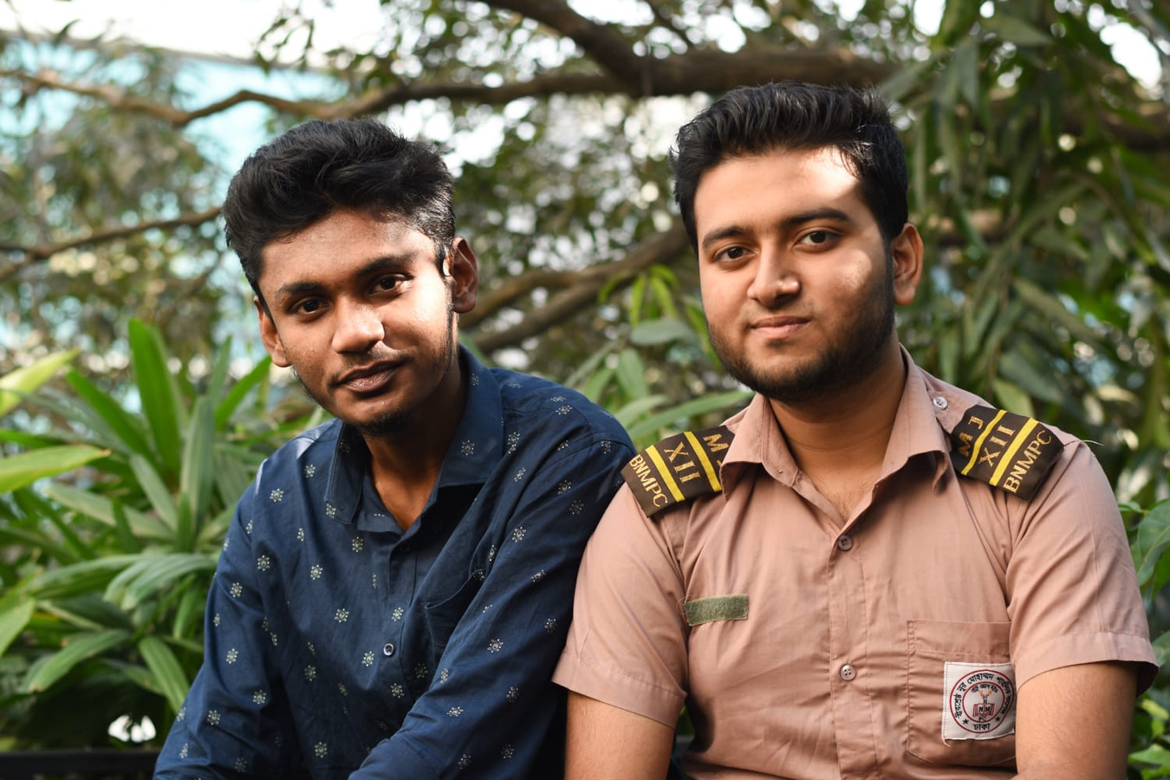
Work Experience
2024-Present
American International University-Bangladesh
Volunteer
·Gathered participants to participate in events
Worked for events
2023-Present
Rafahia
Director
Manage communication with customers.
Update, edit, merge and delete customer data according to product updates
2022-2023
Amar Somoy Amar Desh
Campus ambassador
Gathered participants to participate in events
Helped to raise funds
2022-2023
Amar Somoy Amar Desh
Volunteer
Helped for environmental conservation
Worked for disaster relief
2022-2023
Fiverr
Graphics Designer
Designed various logos and submitted them to the clients.
Communicated with international buyers to design according to their preferences
2022-2023
Sheikh Jamal Cricket Academy
Player
Played domestic matches
Led the team in the matches

Slide 7
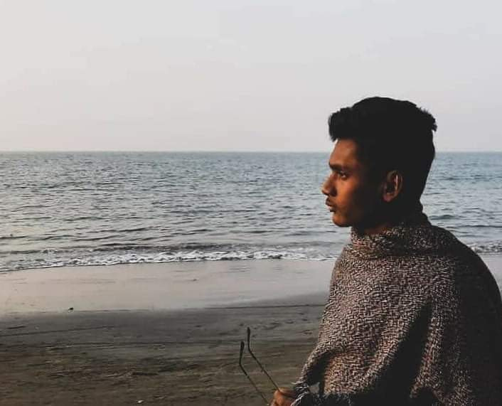
Skills
Java, HTML, CSS, C, C++, SQL
Adobe Illustrator, Photoshop
MS Word, Excel, Powerpoint
Customer Service & Communication
Attention for Details
Basic Hardware & Software Development
Languages
Bangla (Native)
English (Professional)
German (Working Proficiency)

Slide 8

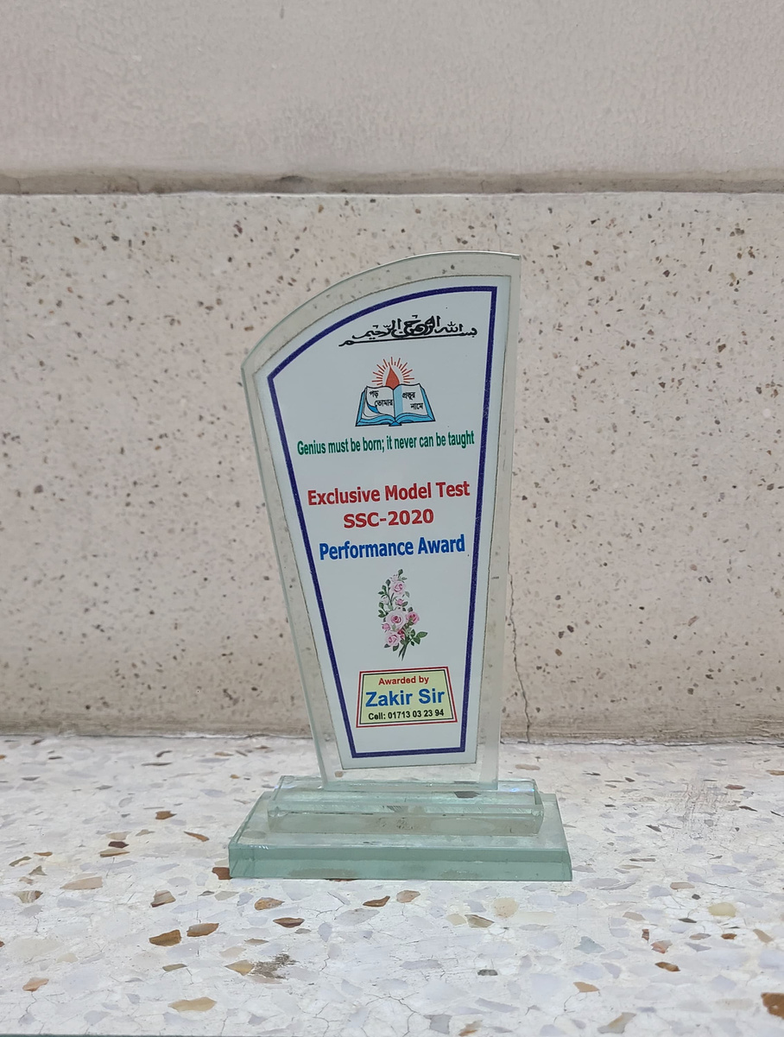
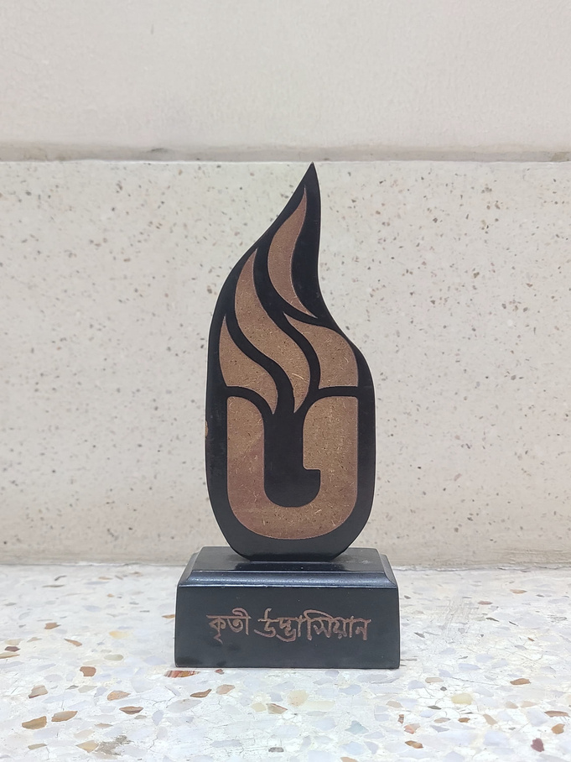
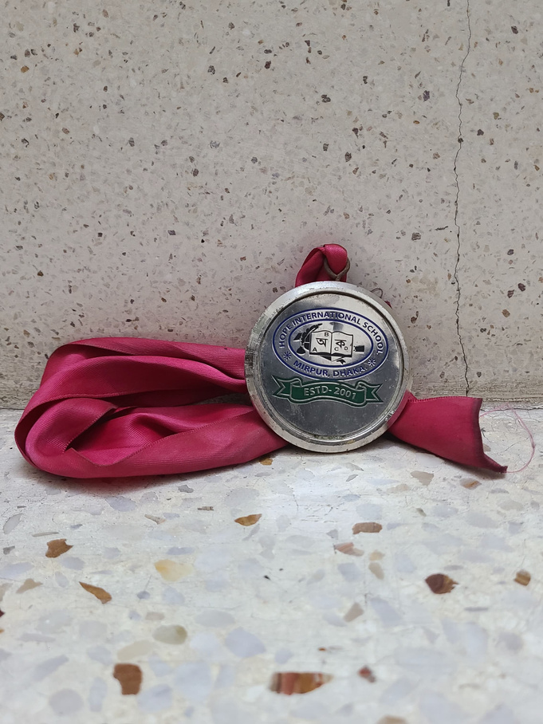
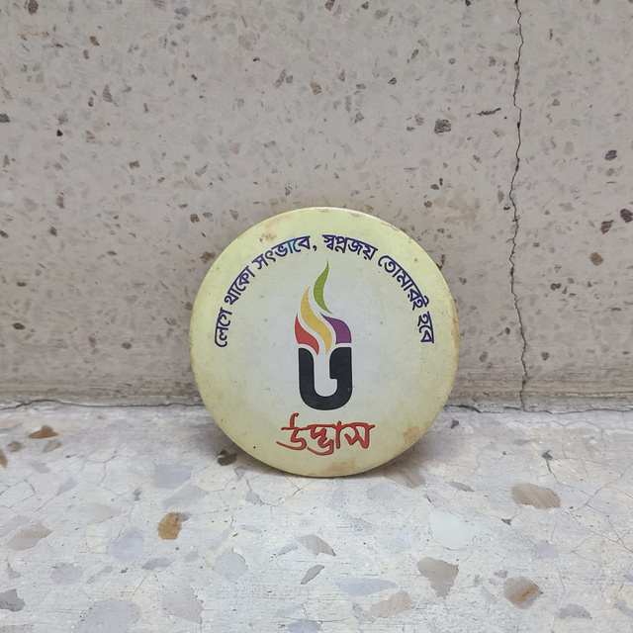
Achievements
An award for being ranked in the model test exam of SSC.
An award for being ranked in the model test exam of SSC.
An award from Udvash for getting gpa in the JSC exam.
An award for being ranked in the pre school.

Slide 9

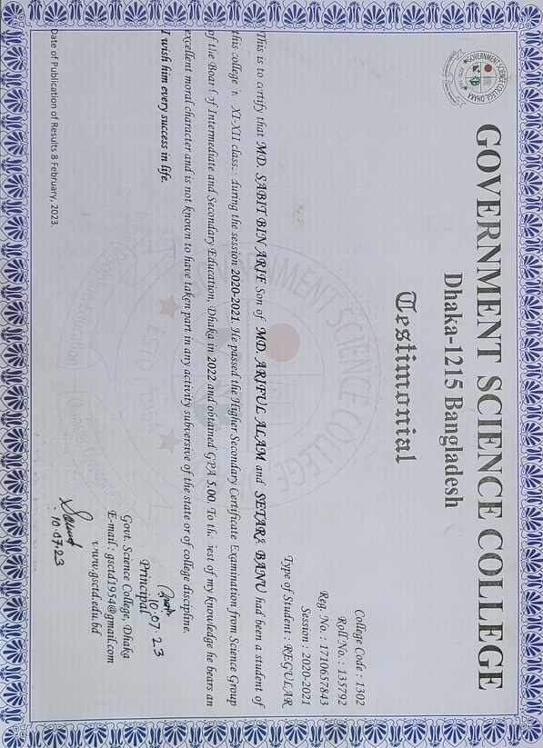
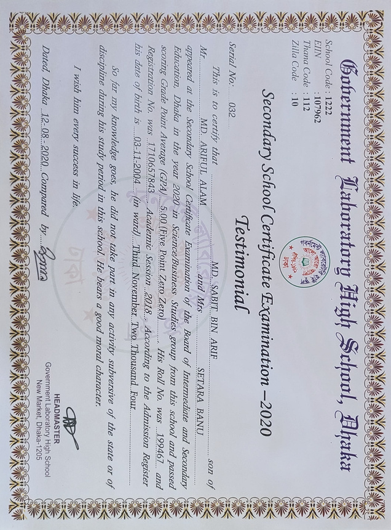
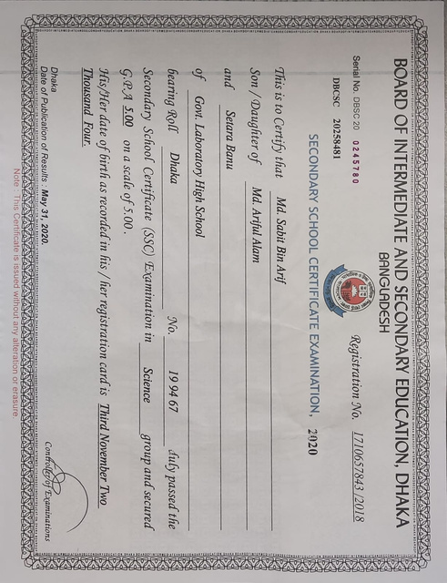

Academic Certificates

Slide 10
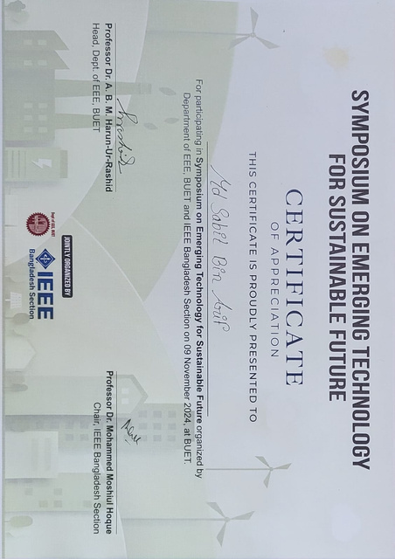

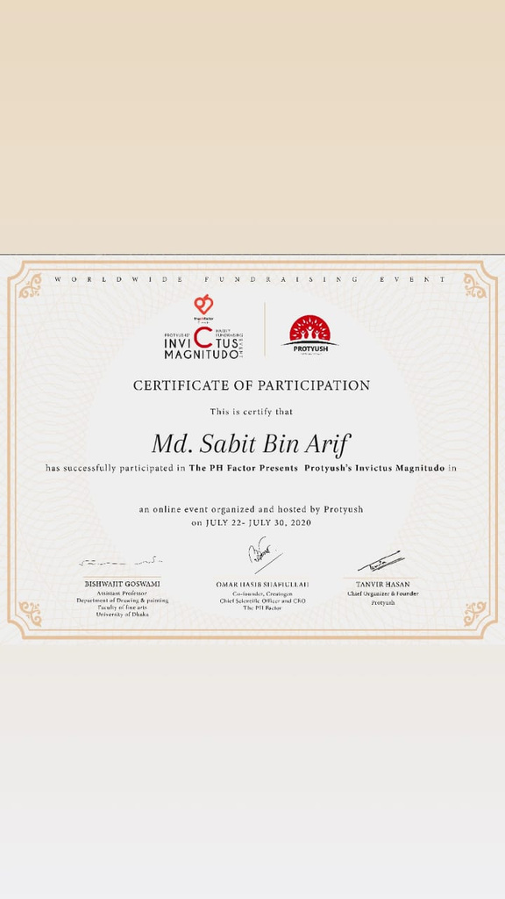
Other Certificates

Slide 11
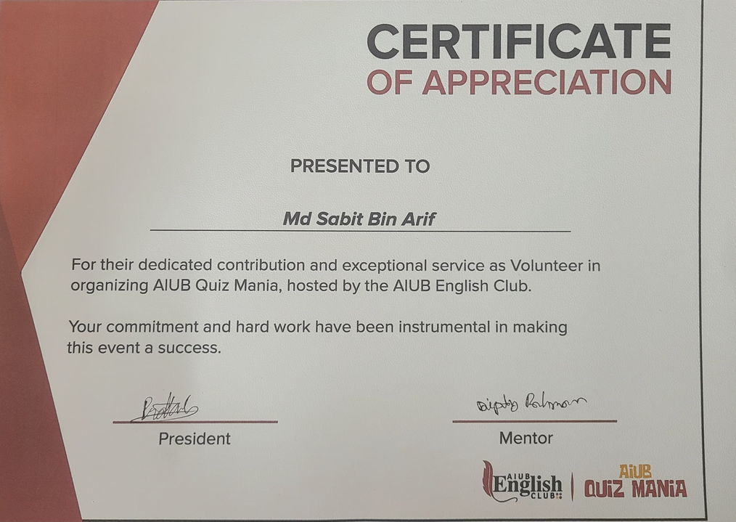
Other Certificates

Slide 12

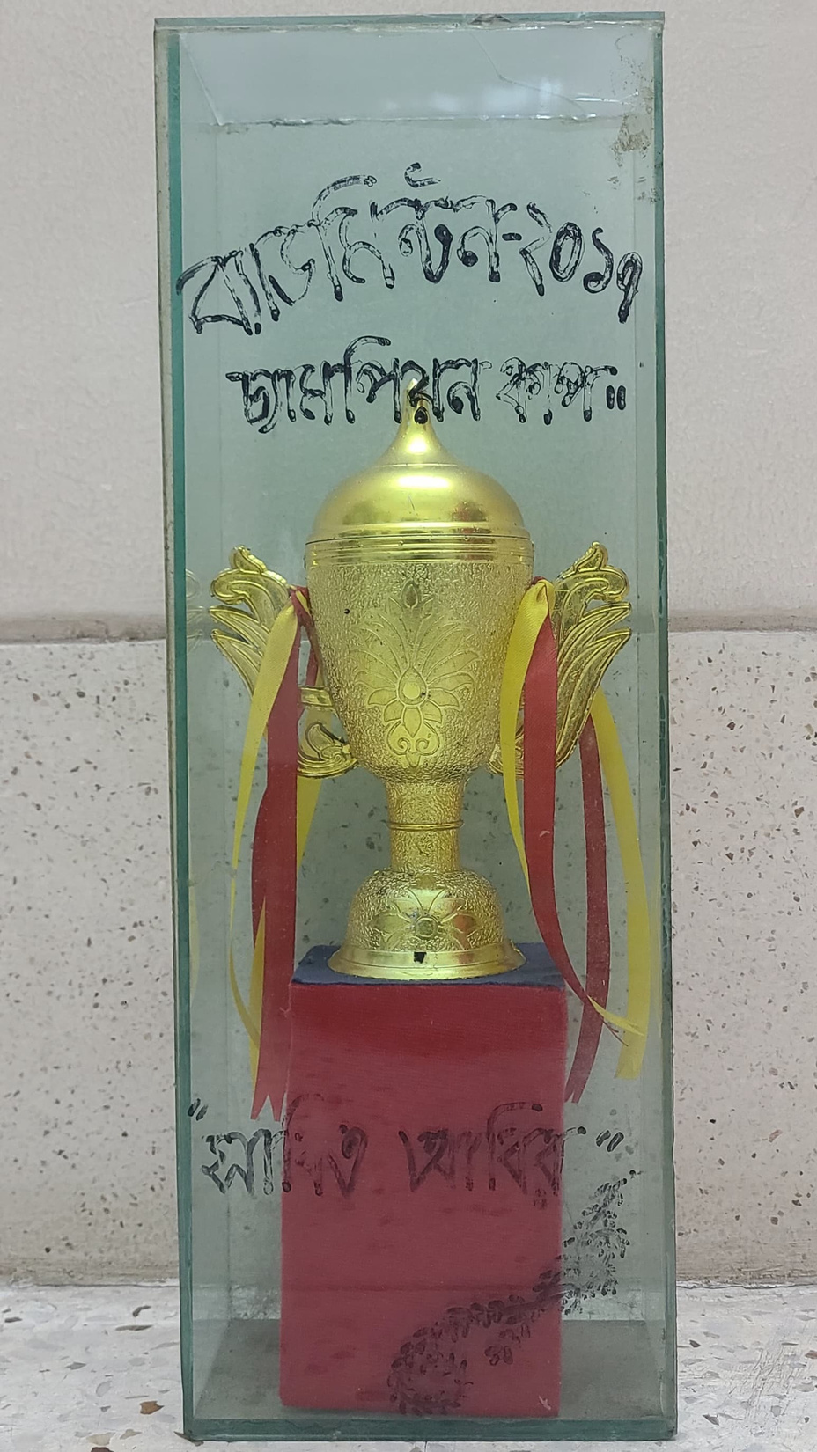
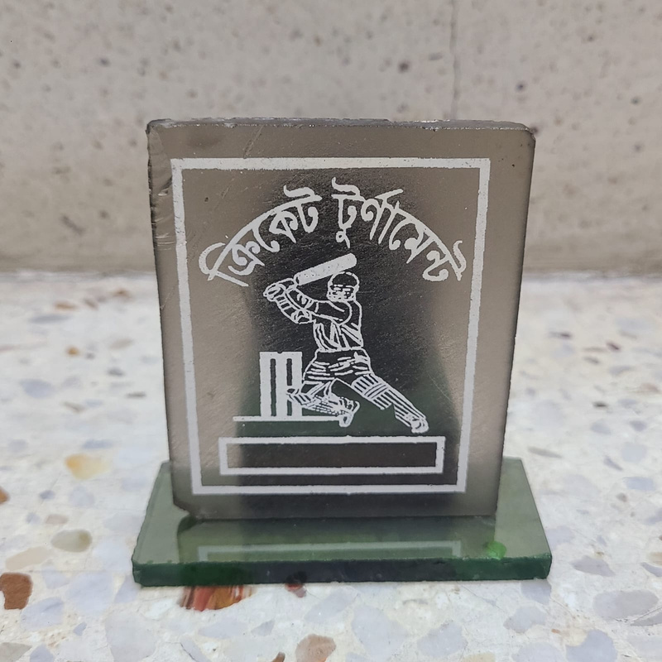
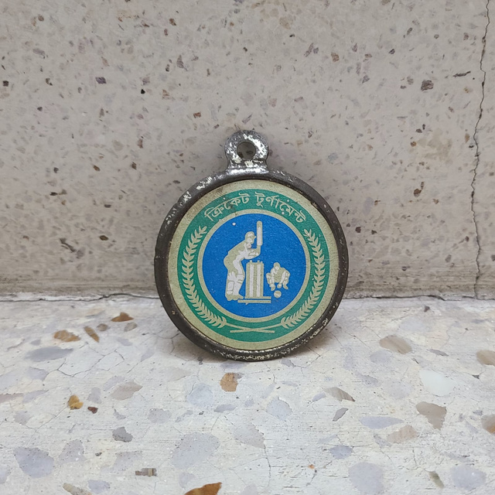

Awards
CHAMPION ON CRICKET TOURNAMENT
CHAMPION ON CRICKET TOURNAMENT
CHAMPION ON SOLO BADMINTON TOURNAMENT

Slide 13
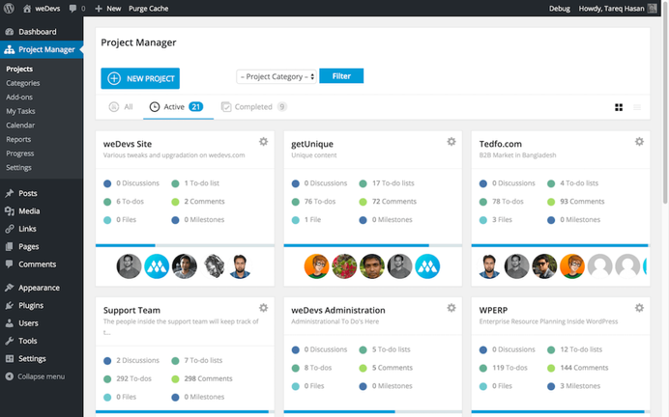

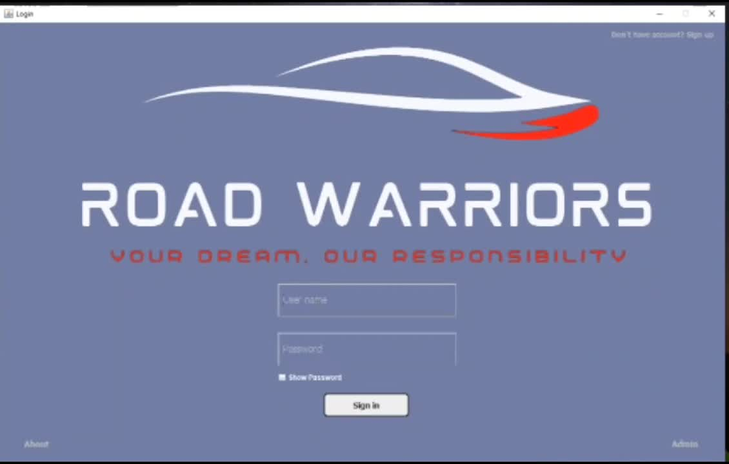
Projects
Onine Shop Management System: A project of Database program that was completed during the semester and submitted at the given time.
Road Warriors: A project of Java program that was completed during the semester and submitted at the given time.
ONLINE SHOP MANAGEMENT
ROAD WARRIORS
2024
2024

Slide 14
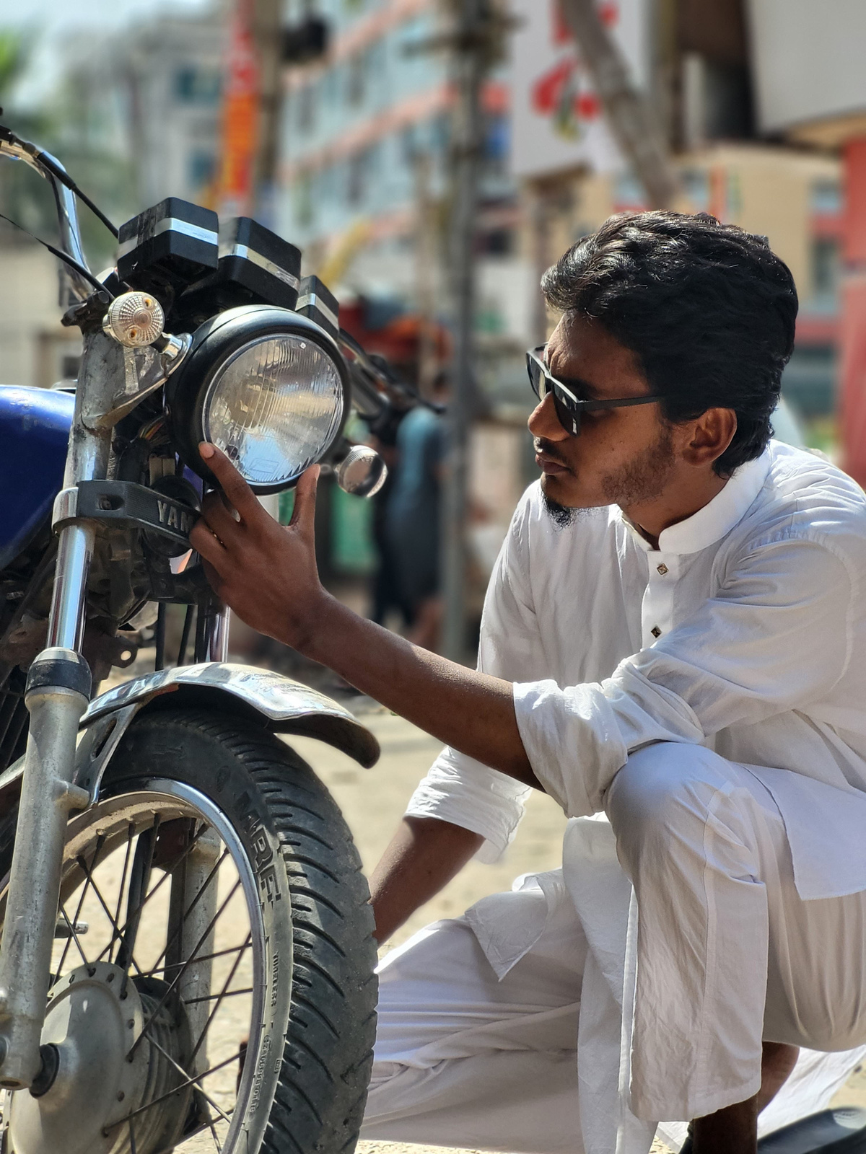
Other Courses
Computational Statistics and Probability
Object Oriented Programming 01 (Java)
Introduction to Programming (C++)
Introduction to Database
Discrete Mathematics
Introduction to Computer Studies

Slide 15
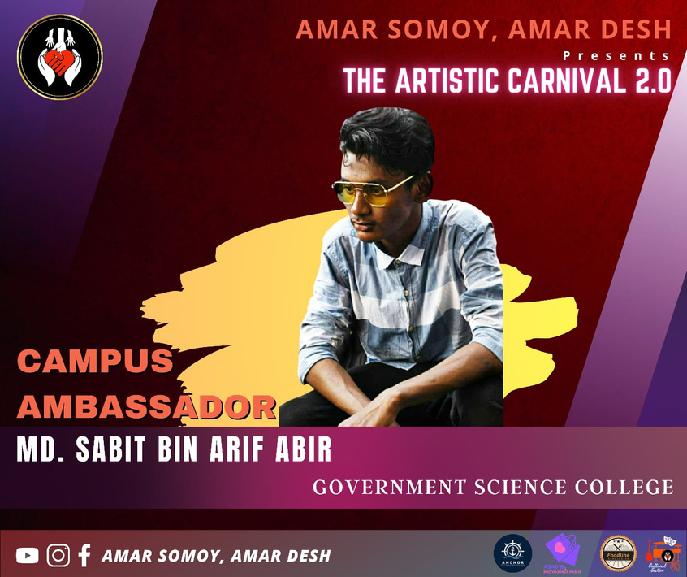
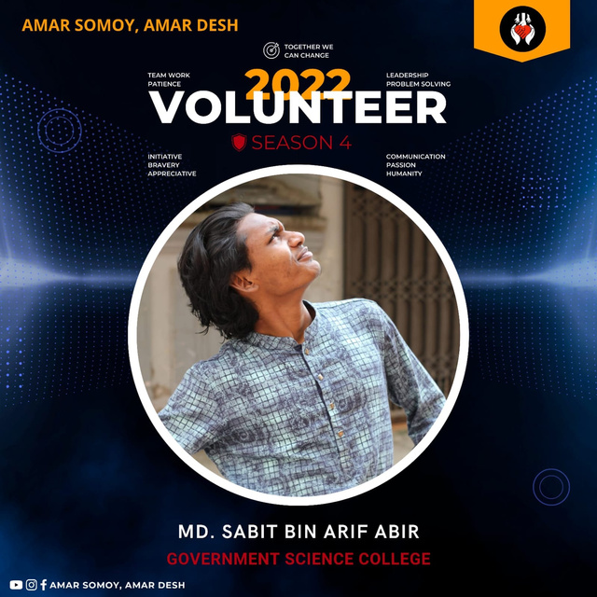
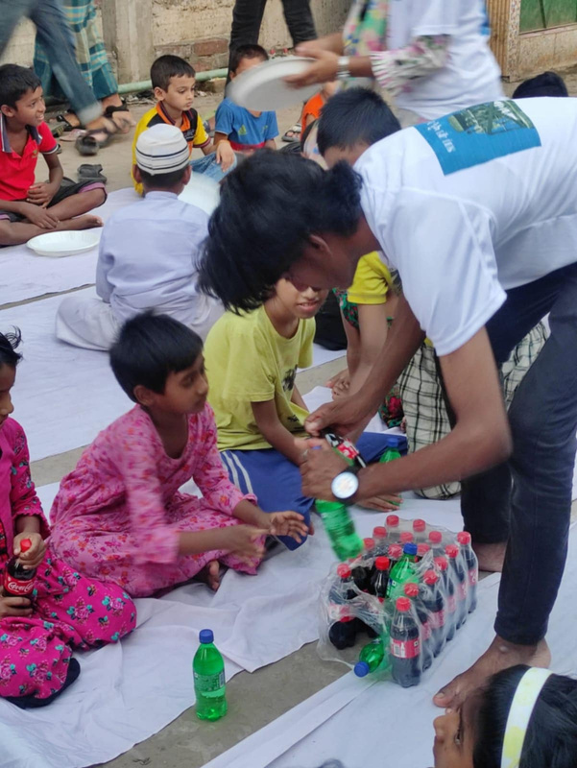
Extra Curricular Activities
Campus Ambassador
Volunteer
Amar Somoy Amar Desh (2023)
Amar Somoy Amar Desh (2022)
Volunteer
Amar Somoy Amar Desh (2022)

Slide 16
Extra Curricular Activities
7th IEOM BANGLADESH CONFERENCE
3rd International Conference on Advancement of Life Sciences
at American International University-Bangladesh
1st International Conference on Agricultural Machinery and Bioresource Engineering
Abstract Accepted
Presented Conference
2nd Place in Poster Presentation
at Mawlana Bhashani Science and Technology University
Abstract Accepted
Presented Conference
at Bangladesh Agricultural University
Abstract Accepted
Presented Conference

Slide 17


Professional Membership
RAFAHIA (ONLINE SHOP)
We import fashion accessories from China and offer them online on this page.

Slide 18
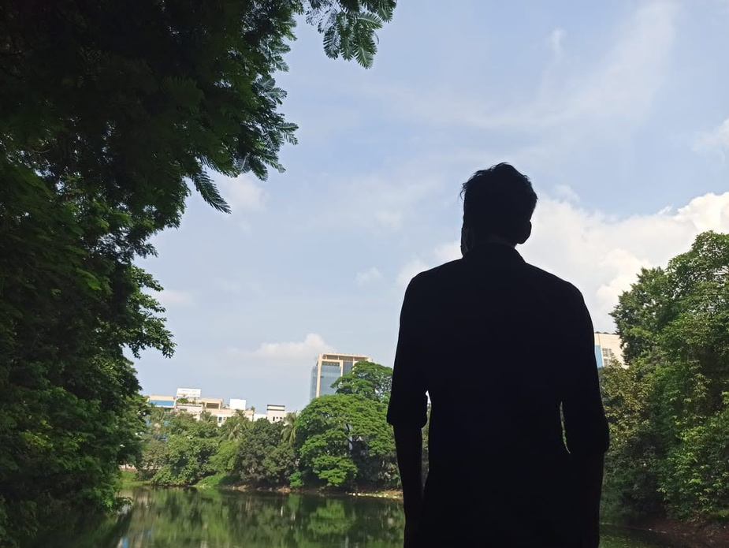


Thank You
Contact Me
+88017211-97089
mdsabitabir@gmail.com
Facebook
Dhaka, Bangladesh

